Slide 1

AI ML for Tech Leaders

Slide 2

Hello! Instructor Introduction
Instructor: Anshu Pandey
Microsoft Certified Trainer
Data Scientist
A Data Scientist and AI Architect having 10+ years of experience of working with organizations to develop Data Science and AI Applications and helping them with AI Transformation.

Slide 3

Artificial Intelligence

Slide 4
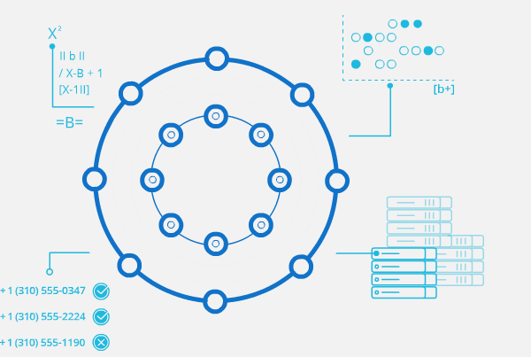
What is Artificial Intelligence?
“The capability of a machine to imitate intelligent human behavior“
Notes:
the theory and development of computer systems able to perform tasks normally requiring human intelligence, such as visual perception, speech recognition, decision-making, and translation between languages

Slide 5
What is Artificial Intelligence?
Machine
or Computers
Artificial Intelligence
+
Intelligence
=

Slide 6
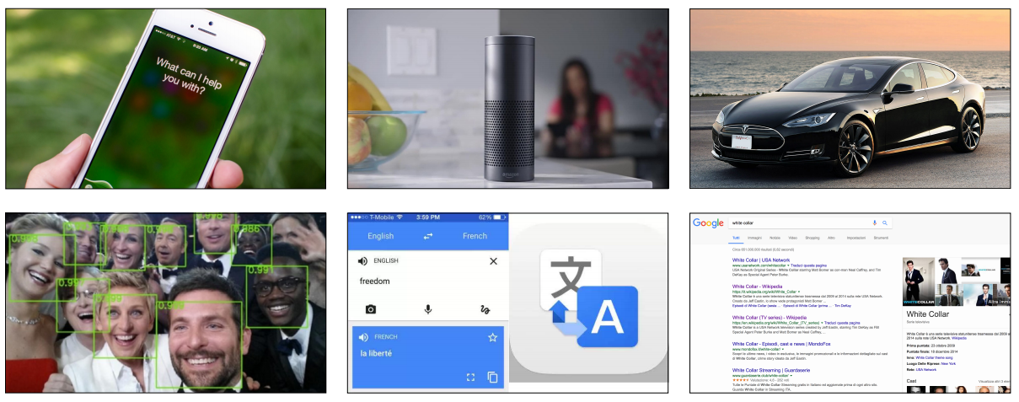
Artificial Intelligence in everyday products

Slide 7

What is Data?
Structured
Business Data, Excel, CSV
Unstructured
Text, Images and Speech

Slide 8
AI Landscape
Artificial Intelligence Collection of algorithms used to build intelligence

Slide 9
AI Landscape
Artificial Intelligence Collection of algorithms used to build intelligence
Machine Learning algorithms which use DATA to build intelligence

Slide 10
AI Landscape
Artificial Intelligence Collection of algorithms used to build intelligence
Machine Learning algorithms which use DATA to build intelligence
Deep Learning AUTOMATED FEATURE ENGINEERING

Slide 11
AI Landscape
Artificial Intelligence Collection of algorithms used to build intelligence
Machine Learning algorithms which use DATA to build intelligence
Deep Learning AUTOMATED FEATURE ENGINEERING
Data Analytics
Statistics, Visualization
Structured Data

Slide 12
AI Landscape
Artificial Intelligence Collection of algorithms used to build intelligence
Machine Learning algorithms which use DATA to build intelligence
Deep Learning AUTOMATED FEATURE ENGINEERING
Data Analytics
Statistics, Visualization
Structured Data
DATA
SCIENCE

Slide 13
AI Landscape
Artificial Intelligence Collection of algorithms used to build intelligence
Machine Learning algorithms which use DATA to build intelligence
Deep Learning AUTOMATED FEATURE ENGINEERING
Data Analytics
Statistics, Visualization
Structured Data
Image Processing
Images,Video(w/o audio)
Unstructured Data
DATA
SCIENCE

Slide 14
AI Landscape
Artificial Intelligence Collection of algorithms used to build intelligence
Machine Learning algorithms which use DATA to build intelligence
Deep Learning AUTOMATED FEATURE ENGINEERING
Data Analytics
Statistics, Visualization
Structured Data
Image Processing
Images,Video(w/o audio)
Unstructured Data
DATA
SCIENCE
COMPUTER VISION

Slide 15
AI Landscape
Text/Speech
Processing
Text/Audio
Unstructured Data
Artificial Intelligence Collection of algorithms used to build intelligence
Machine Learning algorithms which use DATA to build intelligence
Deep Learning AUTOMATED FEATURE ENGINEERING
Data Analytics
Statistics, Visualization
Structured Data
Image Processing
Images,Video(w/o audio)
Unstructured Data
DATA
SCIENCE
COMPUTER VISION

Slide 16
AI Landscape
Text/Speech
Processing
Text/Audio
Unstructured Data
Artificial Intelligence Collection of algorithms used to build intelligence
Machine Learning algorithms which use DATA to build intelligence
NATURAL
LANGUAGE
PROCESSING - NLP
Deep Learning AUTOMATED FEATURE ENGINEERING
Data Analytics
Statistics, Visualization
Structured Data
Image Processing
Images,Video(w/o audio)
Unstructured Data
DATA
SCIENCE
COMPUTER VISION

Slide 17
AI Landscape
Text/Speech
Processing
Text/Audio
Unstructured Data
Artificial Intelligence Collection of algorithms used to build intelligence
Machine Learning algorithms which use DATA to build intelligence
NATURAL
LANGUAGE
PROCESSING - NLP
Deep Learning AUTOMATED FEATURE ENGINEERING
Data Analytics
Statistics, Visualization
Structured Data
Image Processing
Images,Video(w/o audio)
Unstructured Data
DATA
SCIENCE
COMPUTER VISION

Slide 18
Artificial Intelligence
Data Science
Computer Vision
Natural Language Processing

Slide 19
Artificial Intelligence
Data Science
Estimating insurance premium, predicting RUL for any medical equipment
Predicting whether customer will buy a product/insurance or not, customer will churn or not
Classifying the customers in different known groups
Risk prediction
Fraud Detection from transactional data
Segmentation of customers, stocks and server logs
Predicting patient readmission into hospital
Detecting anomalies in access management, data control, insurance claims, patient behaviour, medical data
Building recommendation systems on tabular data
Computer Vision
Natural Language Processing

Slide 20
Artificial Intelligence
Data Science
Face Recognition, Emotion Recognition
Optical Character Recognition for scanned documents
Document verification, authentication
Object Detection and Classification from images
Identifying forgery in the images
Detecting patterns from medical imaging using segmentation.
Motion Detection from videos
Image restoration, colouring and pattern transfer
Action Prediction
Computer Vision
Natural Language Processing

Slide 21
Artificial Intelligence
Data Science
Text/document classification
Social Media Text mining and Analysis
Speech to Text and Text to Speech conversion
Caption generation
Machine Translation
Sentiment analysis from text
Chatbots
Speaker recognition
Personal Assistant, Sentence Correction
Text Generation, Similarity Matching, Topic Modelling
Computer Vision
Natural Language Processing

Slide 22
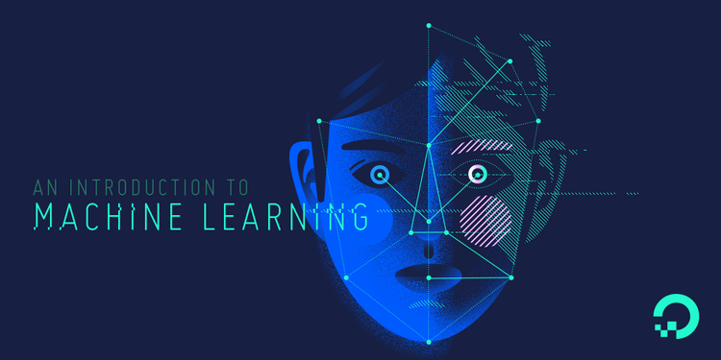

Slide 23

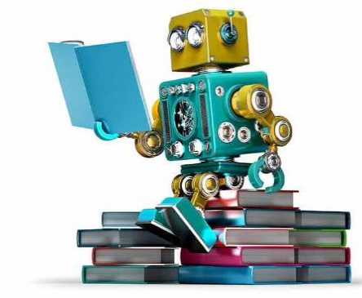


Slide 24
Machine learning is a field of computer science that gives computers the ability to learn without being explicitly programmed.
—Arthur Samuel, 1959

Slide 25
Manufacturing | Retail | Financial Services
Predictive maintenance or condition monitoring Warranty reserve estimation Propensity to buy Demand forecasting Process optimization Telematics | Predictive inventory planning Recommendation engines Upsell and cross-channel marketing Market segmentation and targeting Customer ROI and lifetime value | Risk Analytics and Regulations Customer Segmentation Cross-selling and up-selling Sales and marketing campaign management Credit worthiness evaluation
Travel and Hospitability | Health Care and Life Sciences | Energy, Feedstock and Utility
Aircraft scheduling Dynamic pricing Social media — consumer feedback and interaction analysis Customer complaint resolution Traffic patterns and congestion management | Alerts and diagnostics from real-time patient data Disease identification and risk stratification Patient triage optimization Proactive health management Healthcare provider sentiment analysis | Power usage analytics Seismic data processing Carbon emissions and trading Customer-specific pricing Smart grid management Energy demand and supply optimization

Slide 26
Programming Languages -
Python | R

Slide 27
Machine Learning Cloud Platforms -
Microsoft Azure ML Studio
https://azure.microsoft.com/en-us/services/machine-learning-studio/
Amazon Machine Learning
https://aws.amazon.com/aml/
SAP Leonardo Machine Learning
https://www.sap.com/india/products/leonardo/machine-learning.html
Google ML Platform
https://cloud.google.com/products/machine-learning/
IBM Machine Learning
https://www.ibm.com/analytics/data-science/machine-learning

Slide 28
Machine Learning Techniques

Slide 29
Discovering patterns in unlabeled data.
Cluster similar documents based on the text content.
Learning based on feedback or reward.
Learn to play chess by winning or losing.
Learning with a labeled training set.
Email spam detector with training set of already labeled emails.
Supervised Learning
Unsupervised Learning
Reinforcement Learning

Slide 30




Supervised Learning
We know what we are trying to predict. We use some examples that we (and the model) know the answer to, to “train” our model. It can then generate predictions to examples we don’t know the answer to.
Examples: Predict the price a house will sell at. Identify the gender of someone based on a photograph.

Slide 31


Unsupervised Learning
We don’t know what we are trying to predict. We are trying to identify some naturally occurring patterns in the data which may be informative.
Examples: Try to identify “clusters” of customers based on data we have on them

Slide 32
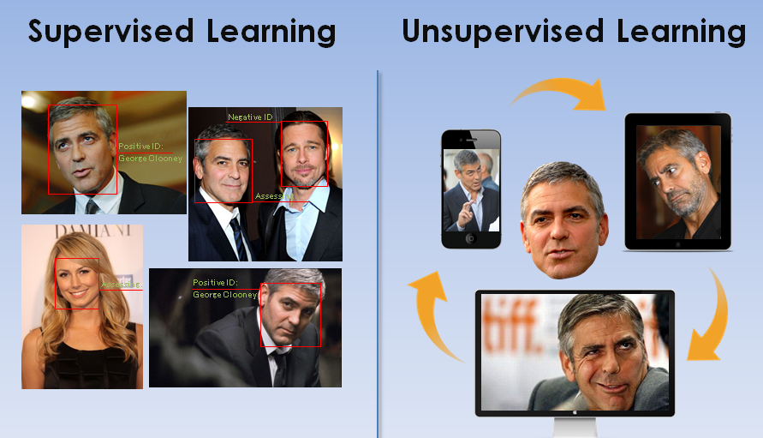

Slide 33
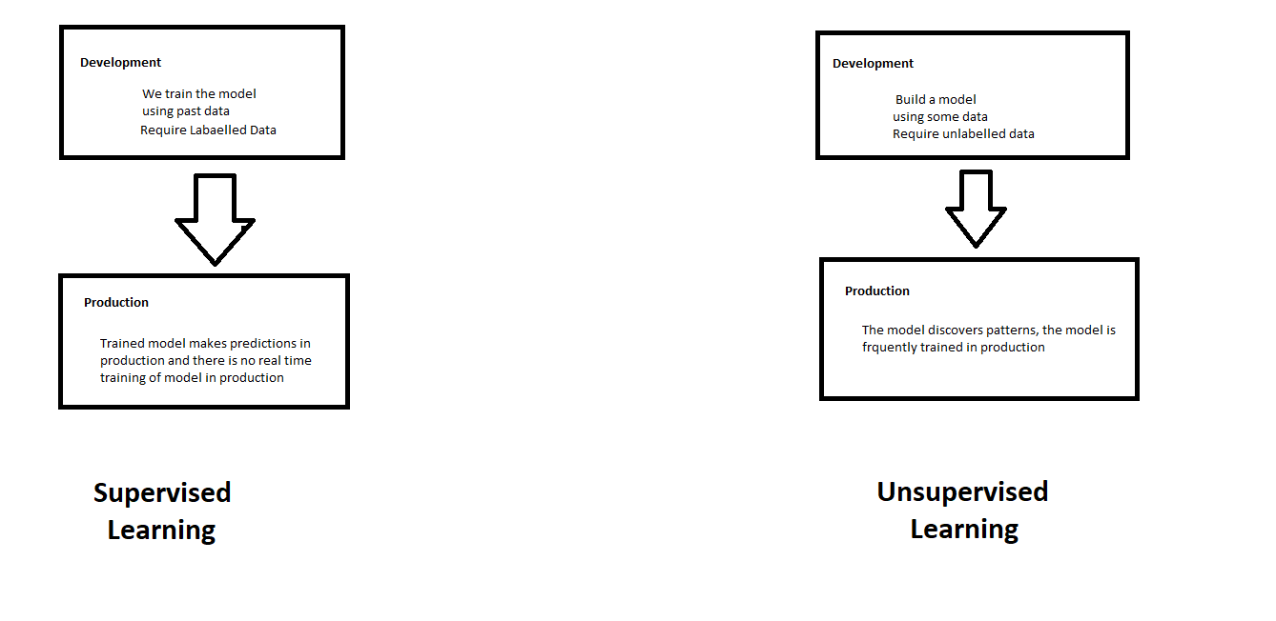
Supervised and Unsupervised Learning

Slide 34
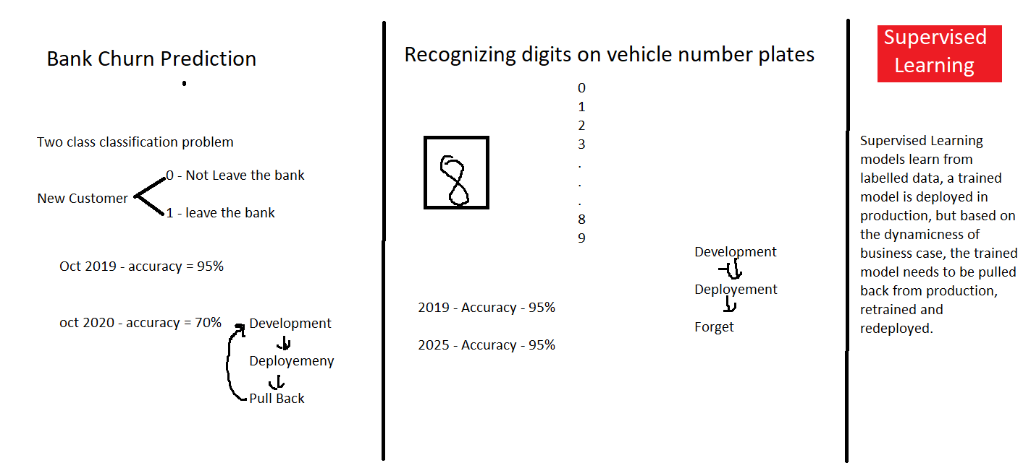

Slide 35
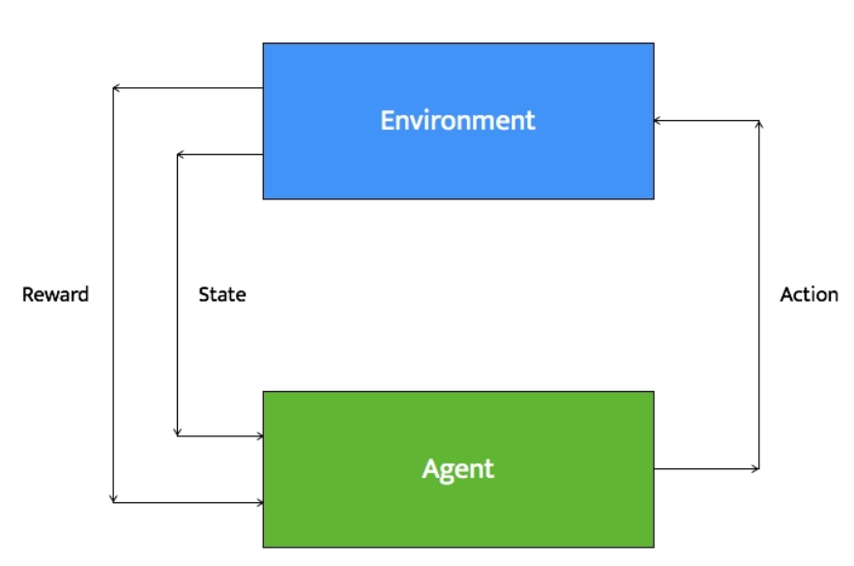
Reinforcement Learning
Reinforcement learning systems can do multiple things simultaneously -- learn by performing a trial and error search, learn the model of the environment it is in, and then use that model to plan the next steps.
Example: Let's consider a robot whose job is to explore a new building. It has to make sure it has enough power left to come back to the base station. This robot has to decide if it should make decisions by considering the trade off between the amount of information collected and the ability to reach back to base station safely.

Slide 36
Types of Problems in Machine Learning

Slide 37
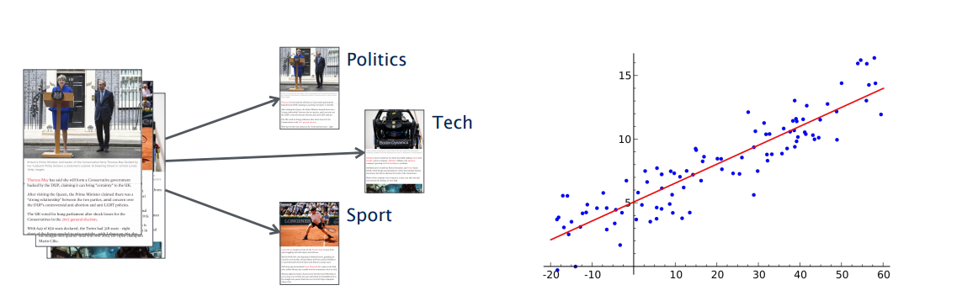
Types of Problems in Supervised Machine Learning -
Classification
(discrete set of possible outcomes)
Regression
(possible outcome can by any numerical value with in a particular continuous range)

Slide 38
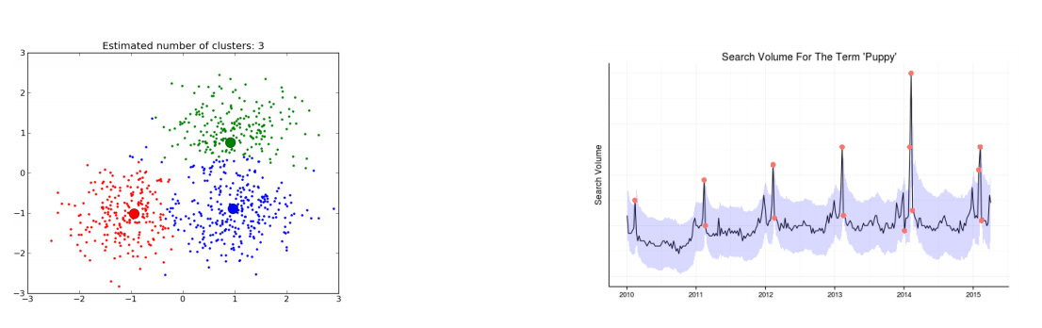
Types of Problems in Unsupervised Machine Learning -
Clustering
(categorization of samples based on similarity in features)
Anomaly Detection
(detecting an anomaly in a general pattern)

Slide 39
Happy Learning!
Stay Tuned for next exciting sessions on diving deeper into Supervised Learning

